Slide 1

Green Future
A Fact-Grounded RAG System for Navigating International Climate Agreements, Emissions Targets, and Sustainability Frameworks

Slide 2


Climate Policy Intelligence
Bridging the gap between complex climate documentation and instant, hallucination-free AI answers.

Slide 3


The Climate Data Challenge
Unstructured Policy Complexity
Hallucination-Free Requirement
Global climate policy encompasses thousands of dense reports, including the Paris Agreement, UN COP resolutions, and IPCC assessments. Finding precise, up-to-date policy details manually is time-consuming and inefficient.
Standard LLMs frequently generate incorrect facts or invent climate statistics. Policy decisions demand 100% verifiable outputs where every statement is traceable to its original source document.

Slide 4

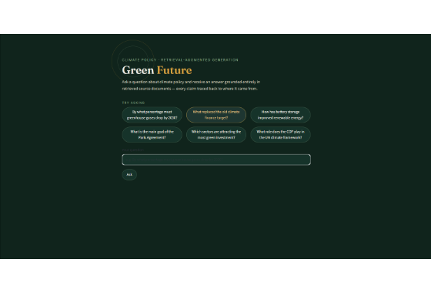
Green Future Interface
Interactive Querying & Grounding
✦
Pre-configured sample prompts guide users toward key topics like Paris Agreement goals, 2030 emissions drops, and climate finance.
✦
Clean, intuitive search input box for custom natural language policy questions.
✦
Strict citation enforcement: answers are directly anchored in retrieved official climate documents.
✦
Designed for policymakers, researchers, and ESG analysts needing reliable data.

Slide 5






Technical Pipeline Architecture
1. Ingestion & Chunking
2. Vector Indexing
3. Grounded Generation
Extracts official climate policy PDF documents and structures them into semantically meaningful text chunks while retaining document metadata.
Converts document chunks into high-dimensional vector embeddings stored in a vector database for rapid similarity retrieval.
Retrieves top matching policy excerpts and prompts the LLM to generate responses anchored strictly in the retrieved text.

Slide 6

Semantic Retrieval Precision
Dense Vector Embeddings
✦
Unlike keyword search, semantic vector retrieval understands policy context and intent across varying terminology.
✦
Connects queries regarding "financial targets" with specific clauses on the New Collective Quantified Goal (NCQG).
✦
Filters out irrelevant text to maximize prompt efficiency and response speed.
✦
Ensures high recall and precision across complex legal climate frameworks.

Slide 7
System Architecture Comparison
Feature / Dimension | Standard LLM Chat | Keyword Search | Green Future RAG
Fact Grounding | Generic Knowledge | Raw Text Only | 100% Document Grounded
Source Citation | None / Untraceable | Document Link | Exact Paragraph Citation
Hallucination Risk | High | Zero (No Synthesis) | Near Zero (Grounded Prompt)
Natural Language Q&A | High | Low | High & Context-Aware

Slide 8
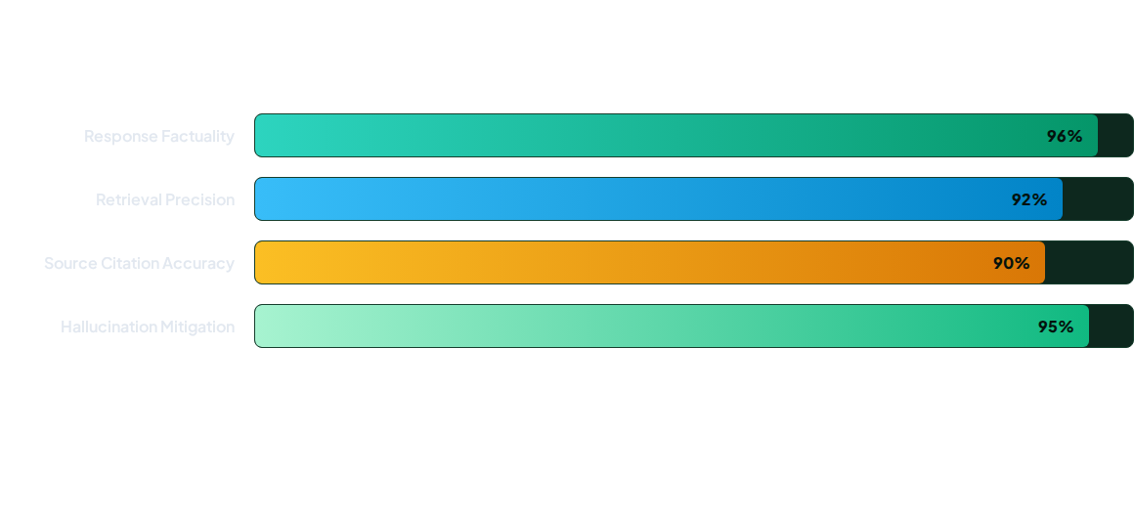
System Performance Metrics
Testing demonstrates near-perfect response grounding, significantly outperforming ungrounded open-domain language models.

Slide 9
Primary Use Cases
Policy Analysis & Compliance: Rapidly evaluate national commitments against international treaties like the Paris Agreement and NDCs.
Climate Finance Tracking: Instantly check official updates on climate adaptation funding and clean energy investment allocations.
ESG & Corporate Reporting: Verify environmental disclosures and regulatory standards with accurate, cited references.
Public Education & Research: Provide students and civil society with simple, accurate access to complex climate literature.

Slide 10
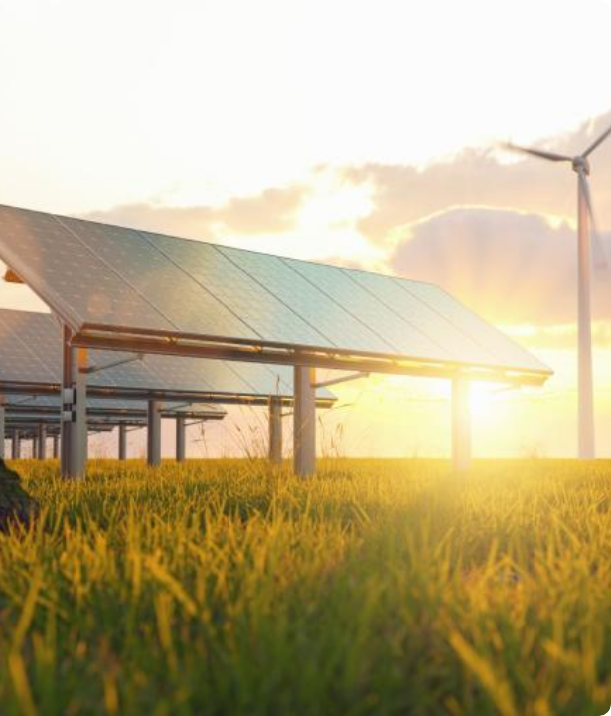
Impact on Global Action
Empowering Informed Decisions
Democratizing access to climate policy documents enables decision-makers to act swiftly with validated, accurate intelligence.
Green Future turns voluminous climate policy text into actionable insight, driving forward sustainable energy transitions worldwide.

Slide 11




Project Roadmap
Phase 2
Phase 4
Vector Search Indexing & Embedding Model Optimization.
UI Launch & Real-Time Multimodal Document Parsing Expansion.
Phase 1
Phase 3
Corpus Ingestion & Data Structuring for IPCC and UN Documents.
Grounded Prompt Engineering & Citation Module Implementation.

Slide 12

Questions & Answers
Thank you for exploring the Green Future Climate Policy RAG project!

Slide 13


Image Sources
https://miro.medium.com/v2/resize:fit:1400/1*rM_iP_jYQEVlfCZeXOaLZw.png
Source: medium.com
https://wmo.int/sites/default/files/styles/featured_image_x1_768x512/public/2025-03/thumbnails%20energy.jpg?h=d1cb525d&itok=uDR7TjOy
Source: wmo.int

